Slide 1


B.E.(I.T.) / MAJOR PROJECT 2026-27
Aegis: Decentralized Identity & Zero Trust Access Control System
      Presented by:
          Owais Shaikh 46
          Zaheen Siddiqui 53
          Prem Hanchate 65
          Hassan Qureshi 68
      Supervisor:
          Prof. Prasad Padalkar
Group No : 17
01
01

Slide 2
B.E.(I.T.) / MAJOR PROJECT 2026-27
INTRODUCTION
Modern applications require secure authentication and fine-grained access control to protect users and resources. The proposed system combines Decentralized Identity, password-less wallet authentication, and Zero Trust authorization to provide secure access without relying on traditional application passwords. MetaMask is used to prove control of a cryptographic wallet through signed challenges, while the backend verifies the user's identity, device, session, and permissions before granting access. Blockchain provides tamper-resistant identity, policy, and revocation information, while MongoDB stores operational data and audit logs.
Key Points
Password-less authentication using MetaMask.
Decentralized Identity (DID) linked to a public key.
Zero Trust access control for every request.
Blockchain-backed identity and revocation records.
Device management and audit logging for additional security.
02
02

Slide 3
B.E.(I.T.) / MAJOR PROJECT 2026-27
LITERATURE SURVEY
Literature / Standard | Key Contribution | Relevance to Project
W3C — Decentralized Identifiers (DIDs) | Defines decentralized, verifiable digital identity independent of centralized identity providers. (W3C) | Supports the DID-based identity component.
NIST SP 800-207 — Zero Trust Architecture | Recommends removing implicit trust and focusing authentication/authorization on users, devices and resources. (NIST Computer Security Resource Center) | Supports the Zero Trust authorization model.
EIP-4361 — Sign-In with Ethereum | Defines wallet-based authentication using signed messages, domain, address and nonce. (Ethereum Improvement Proposals) | Supports MetaMask/challenge-response authentication.
NIST ZTA Access-Control Model | Applies Zero Trust principles to application/service-level access control instead of relying mainly on network location. (NIST) | Supports resource-level authorization in the proposed system.
Literature Gap :
Existing standards and approaches address decentralized identity, wallet authentication, or Zero Trust individually. The proposed project combines these concepts with device revocation, blockchain-backed policy/revocation state and tamper-resistant auditing into one access-control architecture.
0
03

Slide 4
B.E.(I.T.) / MAJOR PROJECT 2026-27
PROBLEM STATEMENT
Traditional authentication systems commonly depend on passwords and centralized identity management, which creates risks such as password theft, phishing, replay attacks, compromised devices, and unauthorized access. A successful login does not necessarily mean that a user should have access to every resource. In addition, stolen devices, outdated permissions, and modified audit records can create further security risks. The system therefore needs to continuously verify identity, device status, session validity, and resource permissions before allowing access.
SCOPE
Decentralized identity and wallet-based authentication
Password-less challenge-response authentication
Zero Trust resource authorization
Device enrolment, replacement and revocation
Blockchain-backed identity, policy and revocation state
MongoDB-based operational data and audit storage
Security auditing and integrity anchoring
4
04

Slide 5
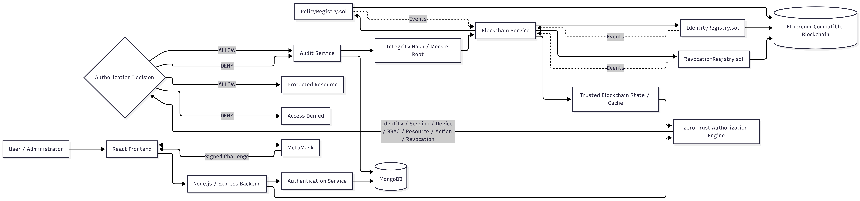
B.E.(I.T.) / MAJOR PROJECT 2026-27
PROPOSED SYSTEM
Core Components
React + MetaMask — user/admin interaction and wallet authentication
Node.js + Express — API, authentication and authorization
MongoDB — operational and persistent application data
Zero Trust Engine — evaluates every protected request
Blockchain Layer — trusted identity, policy and revocation state
Audit Layer — records security and access events
05

Slide 6
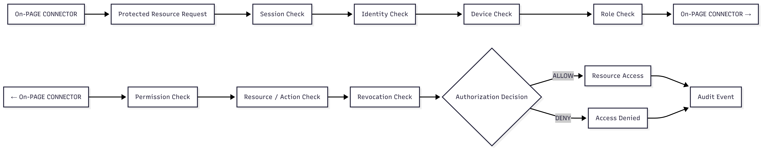
B.E.(I.T.) / MAJOR PROJECT 2026-27
PROPOSED SYSTEM
Authentication
Connect wallet
Request challenge
Sign challenge
Verify signature
Identify user
Create session
Authorization
Validate session
Validate identity
Validate device
Check role and permission
Check resource/action
Check revocation state
Allow or deny
Generate audit event
06

Slide 7
B.E.(I.T.) / MAJOR PROJECT 2026-27
PROPOSED SYSTEM
Zero Trust Authorization Algorithm
Input:
identity, device, session, resource, action
Decision checks:
Session is valid
Identity is ACTIVE
Device is ACTIVE
Required role exists
Required permission exists
Resource/action is permitted
Identity/device/permission are not revoked
Network/risk context is acceptable
07

Slide 8
B.E.(I.T.) / MAJOR PROJECT 2026-27
Experimental Setup — Dataset / Input Data
Input Data
Test scenarios
Valid authentication
Invalid signature
Replayed challenge
Expired challenge
Revoked identity
Expired/revoked session
Unknown/revoked device
Unauthorized resource
Permission revocation
Unauthorized admin action
Blockchain synchronization delay
Data | Purpose
Wallet address | Decentralized identity
Challenge / nonce | Authentication
Session | Access validity
Device information | Device trust
Roles & permissions | Authorization
Resources & actions | Resource-level control
Revocation state | Access invalidation
Audit events | Security monitoring
08

Slide 9
B.E.(I.T.) / MAJOR PROJECT 2026-27
Experimental Setup — Technology Stack
Frontend: React + Vite → MetaMask + ethers.js
Backend persistence: Node.js + Express + Zod → MongoDB + Mongoose
Backend blockchain integration: Node.js + Express + ethers.js → Deployed Smart Contracts
Smart contracts: Solidity + Hardhat
Security: OpenZeppelin AccessControl → Smart Contracts
Testing: Vitest + Supertest + Hardhat + Chai
09

Slide 10
B.E.(I.T.) / MAJOR PROJECT 2026-27
Experimental Setup — Implementation Plan
Semester I — Major Project I
Foundation & MVP Core
Requirements and architecture
MongoDB persistence
Identity and authentication
Session management
Zero Trust authorization
Device lifecycle
Smart-contract design
Initial testing
Semester II — Major Project II
Integration & Production MVP
Functional smart contracts
Blockchain event synchronization
Trusted blockchain cache
MetaMask frontend integration
Admin dashboard
Persistent audit logging
Merkle/hash anchoring
End-to-end security testing
Final deployment and demonstration
10

Slide 11
B.E.(I.T.) / MAJOR PROJECT 2026-27
References
[1] M. Sporny, A. Guy, M. Sabadello, D. Longley, M. Reed, O. Steele, and C. Allen, “Decentralized Identifiers (DIDs) v1.0,” W3C Recommendation, Jul. 19, 2022.
[2] S. Rose, O. Borchert, S. Mitchell, and S. Connelly, Zero Trust Architecture, NIST Special Publication 800-207, National Institute of Standards and Technology, Gaithersburg, MD, Aug. 2020. doi: 10.6028/NIST.SP.800-207.
[3] W. Chang, G. Rocco, B. Millegan, N. Johnson, O. Terbu, and others, “Sign-In with Ethereum,” Ethereum Improvement Proposal 4361, Oct. 2021.
[4] OpenZeppelin, “Access Control,” OpenZeppelin Contracts Documentation, 2026.
11

